Slide 1
Database

Slide 2
Basic Definitions
Data is a known facts that can be recorded and that have implicit meaning
Database is a collection of related data or facts
arranged in a specific structure..
Ex: telephone directory, address book, T.V.Guide, airline reservation system, motor vehicle registration records ,papers in your filing cabinet, files on your computer hard drive.
Database Management System(DBMS) is a software tool that allows people to store,access,and process data into useful information.
DBMS is a computerized record-keeping system

Slide 3
Why Database Or Benefits of Database
Manages very large amounts of data.
Supports efficient access to very large amounts of data.
Supports concurrent access to very large amounts of data.
Redundancy can be reduced.
Contradiction can be avoided.
Synchronization can be achieved.
Security restrictions can be applied.
Backup and Recovery.

Slide 4
Database
Three important terms to know about database
Fields or Columns – each unique item or attributes of the object described by the table.
Records or Rows – each complete set of fields or all the related data about one object .
Table – a complete collection of records.
Reg.No Name Sem Branch
0016 N. Deepak 3 CSE
0674 K. Gopal 5 MECH
2901 Kanchana 2 CSE

Slide 5
Elements of Database
Forms are documents that are filled in to create records.
A form is nothing more than a custom view of the table that typically shows one record at a time and includes special controls and labels that make data entry less confusing.
Reports are documents that display a selected portion of a database’s information in an easily read format.

Slide 6
Users of Database
Application Programmer is responsible for writing
programs that use the database.
End-User accesses the database from a terminal.
User can perform the following functions
Creation, Deletion, Retrieval ,Modification
Database Administrator is responsible for overall
control of the database system.
Managing resources ,Creation of user accounts
Providing security and authorization
Managing poor system response time
System Recovery ,Updating the Database

Slide 7
Working with a Database
User can perform the following data management functions
Creating Tables
Viewing Tables
Sorting Tables
Creating Queries
Generating Reports

Slide 8
Creating Tables
1.Define each field in the table by following a three step process.
a. Name the field.
b. Specify the field type.
i. Text Field (character or string or alphanumeric)-stores strings &
letters that are not used for calculations.
ii. Numeric Field – stores numbers
iii. Date or Time Field – stores Date & Time
c. Specify the field size.
2.Entering data in a table

Slide 9
Querying Database
Query :A user-constructed statement that describes data and criteria so that the DBMS can gather the desired data and construct specific information.
Allows DBMS to locate records.
Establish relationships or links between tables to update records.
List a subset of records.
Perform calculations
Delete outdated records
Perform other management tasks.

Slide 10
Database Examples
Class roster
Hospital patients
Literature (published articles in a certain field)
Genomic information
Protein structure
Taxonomy

Slide 11
Database Types (cont.)
Type | Typical number of users | Typical architecture | Typical size
Personal | 1 | Desktop/Laptop/ PDA | MB
Workgroup | 5-25 | Client/server:2 tier | MB-GB
Department | 25-100 | Client/server:3 tier | GB
Enterprise | >100 | Client/server: distributed | GB-TB
Internet | >1000 | Web sever & application servers | MB-GB

Slide 12
Data Management Terminology
Entity - a person, place, thing, or event about which information is maintained
Records describe entities
Attribute - each characteristic or quality describing a particular entity
Fields describe attributes
Primary Key - field that uniquely identifies the record
Secondary Key - field does not identify the records uniquely, but can be used to form logical groups of records

Slide 13
Basics of Data Arrangement and Access
The Data Hierarchy
Recall…8 bits => 1 byte => 1 character
Field - a logical grouping of characters into a word, a small group of words, or a complete number
Record - a logical grouping of related fields
File - a logical grouping of related records
Database - a logical grouping of related files

Slide 14
Traditional File Environment
The organization has multiple applications with related data files
Each application has a specific data file related to it, containing all the data records needed by the application
Each application comes with an associated application-specific data file

Slide 15
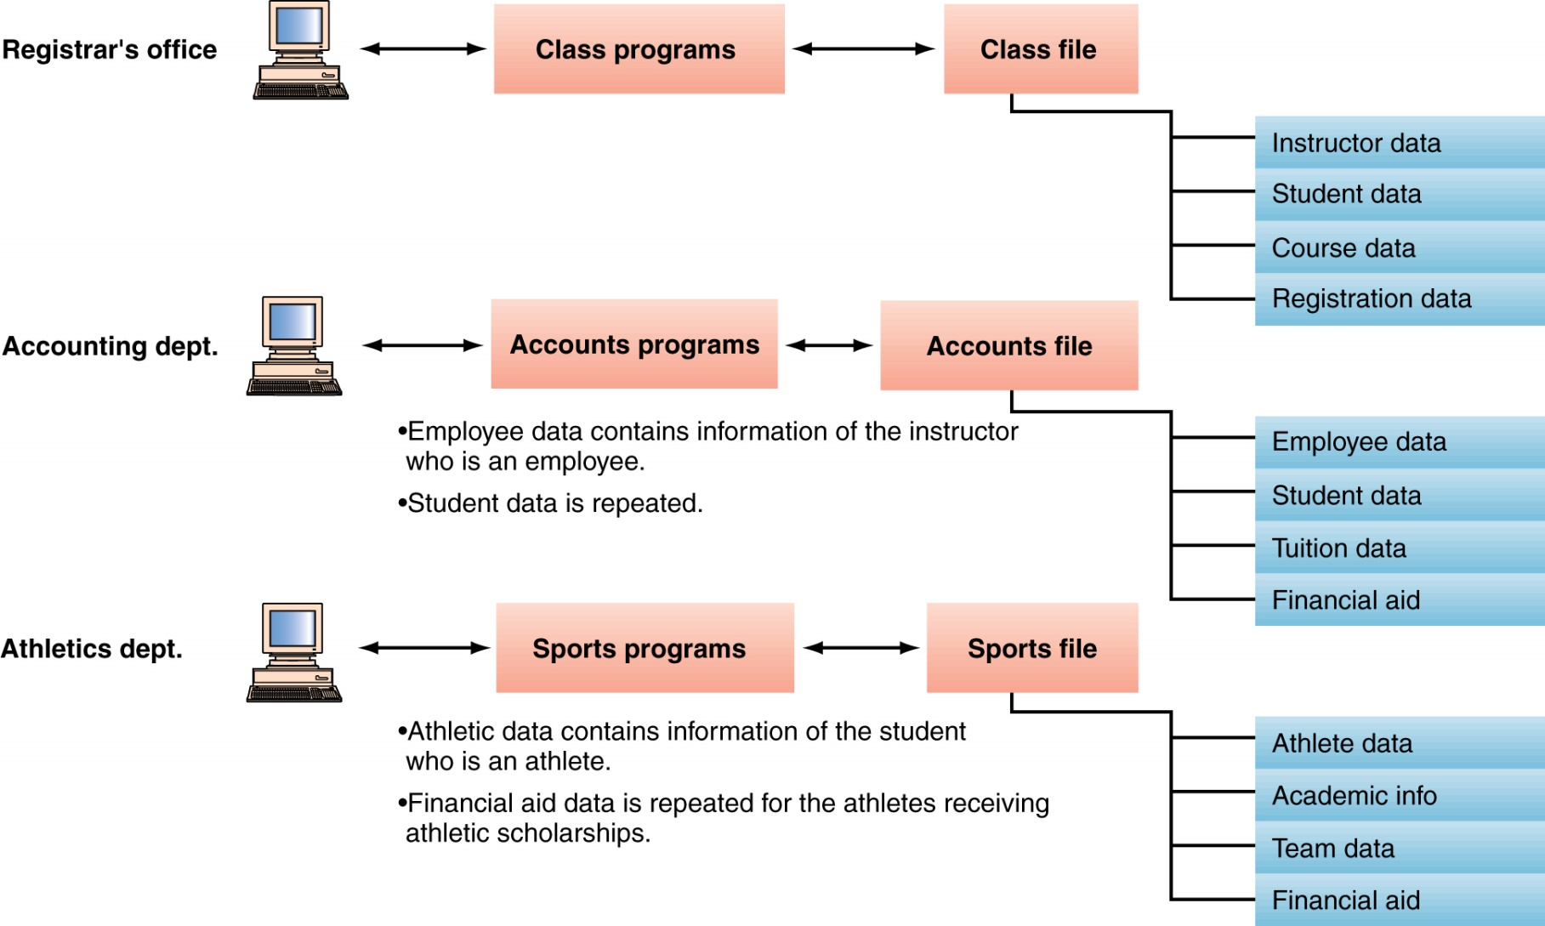
Traditional File Environment (continued)

Slide 16
Problems: Traditional File Environment
Data redundancy – same piece of data found in several places.
Data inconsistency – various copies of data no longer agree.
Data isolation – data in several application data files is hard to access and integrate.
Security – may be difficult to limit access to various data items in applications.
Data integrity – data must be accurate and correct.
Application/data dependence – applications are developed based on the way data is stored.
Notes:
Data redundancy – the same piece of data may be repeated in many places
Data inconsistency – the various copies of the data may have different values
Data isolation – hard to access data from different applications
Security – protect the data so that only authorized users have access – harder in a file environment with so many applications
Data integrity – making sure the data is accurate and in the correct form
Application / data independence – desirable not to have to develop applications based on the way the data is stored. Need to have the two independent of each other.

Slide 17
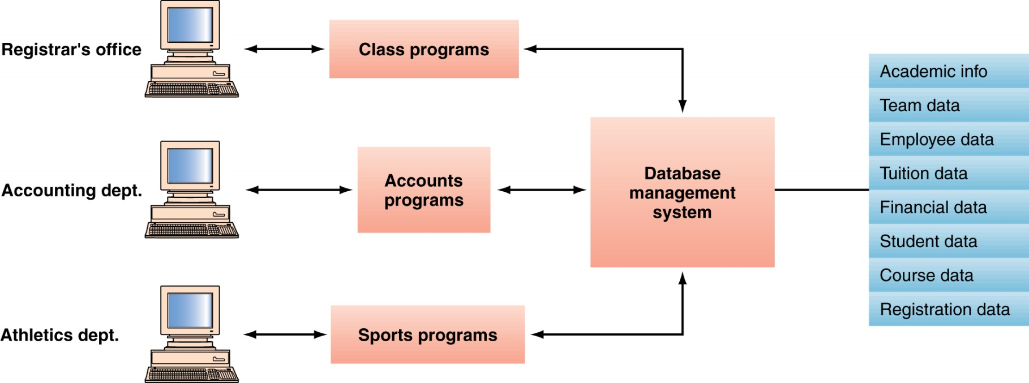
Database Management System (DBMS)
Database : The Modern Approach
The database management system provides access to the data

Slide 18
Locating Data in Databases
Two choices: Centralized or Distributed
Option 1: Centralized database
All the related files are in one physical location
Provides database administrators with the ability to work on a database as a whole at one location
Data consistency is improved and security is easier
Files are only accessible via the centralized host computer
Recovery from disasters is easier
Vulnerable to a single point of failure
Speed problem due to transmission delays

Slide 19
Locating Data in Databases (continued)
Option 2: Distributed database
Complete copies of a database, or portions of a database, are in more than one location, close to the user
Type 1: Replicated database
Copies of database in many locations
Reduced single-point-of-failure problems
Increased user access responsiveness
Type 2: Partitioned databases
A portion of the database in each location
Each location responsible for its own data

Slide 20
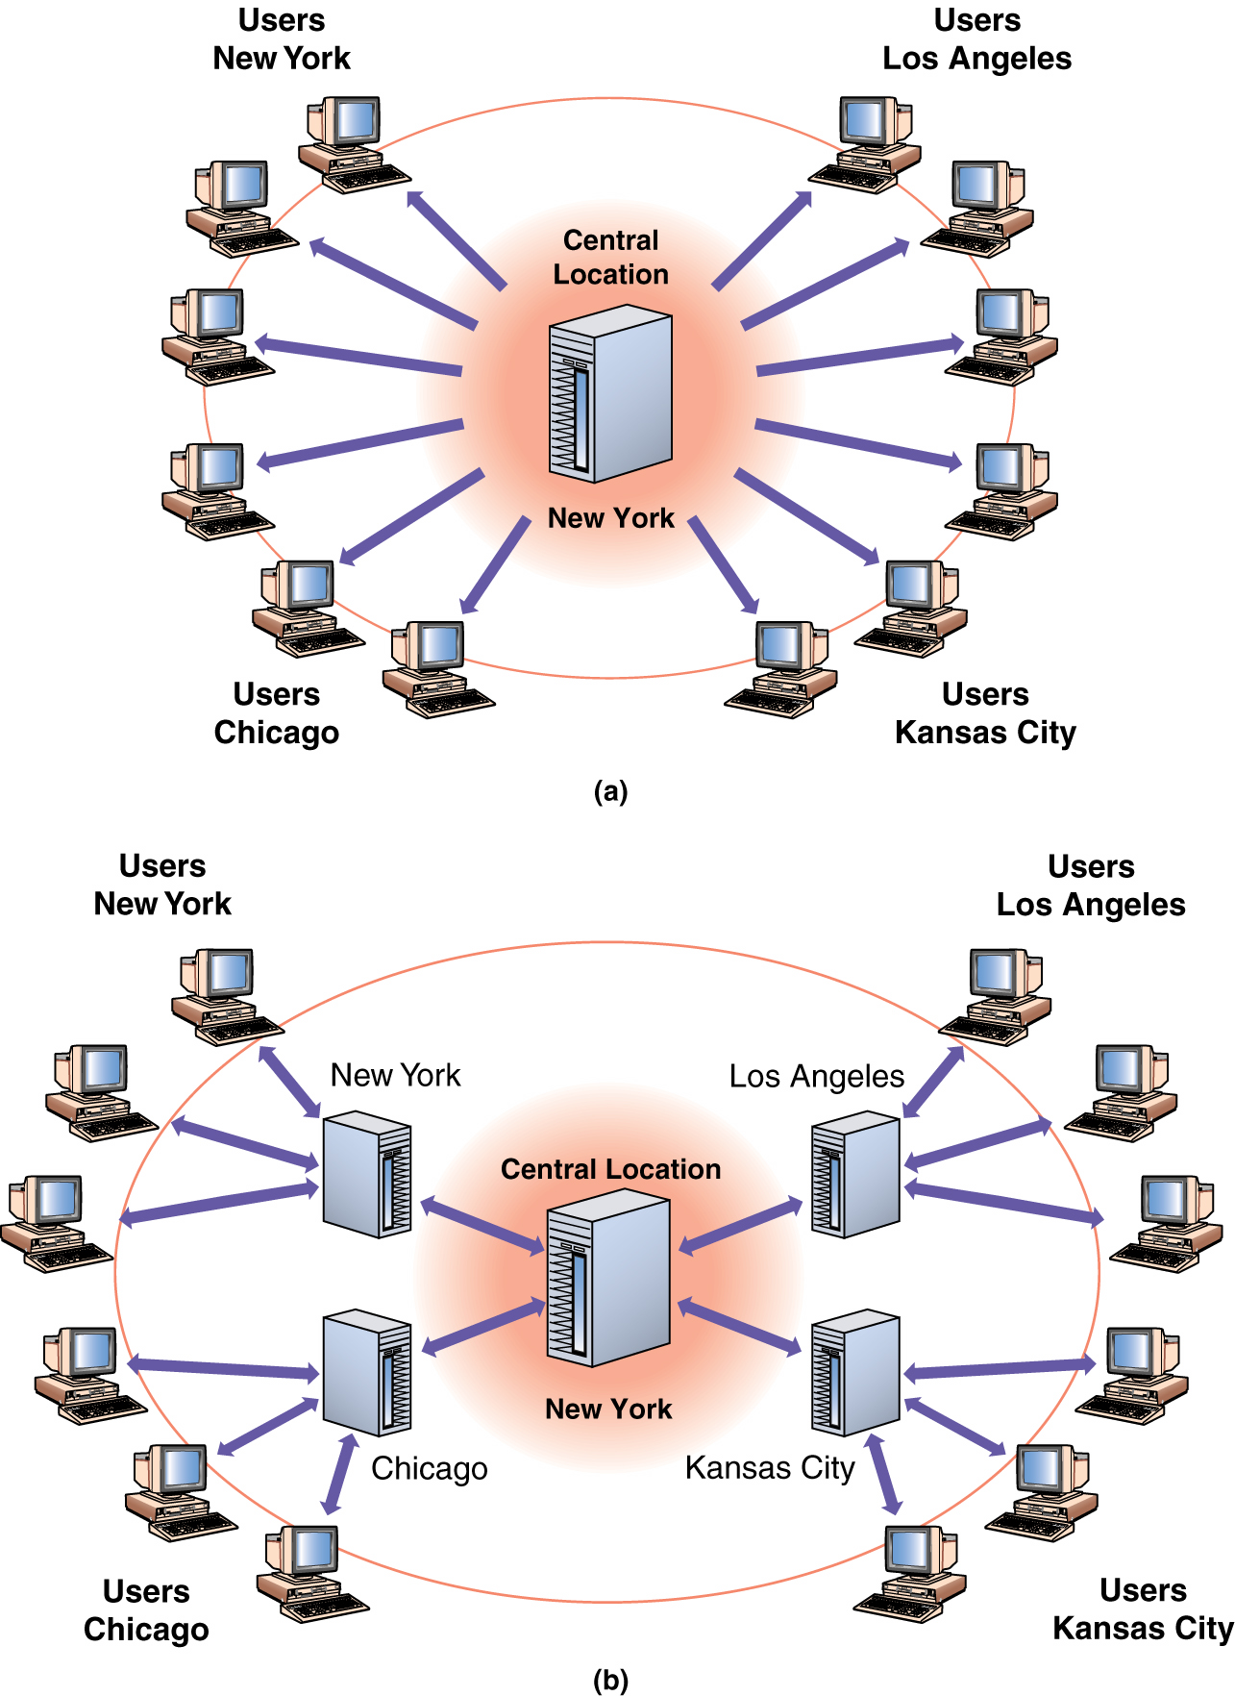
Locating Data in Databases (continued)

Slide 21
TWO MAIN TYPES
Centralized Database
Distributed Database

Slide 22
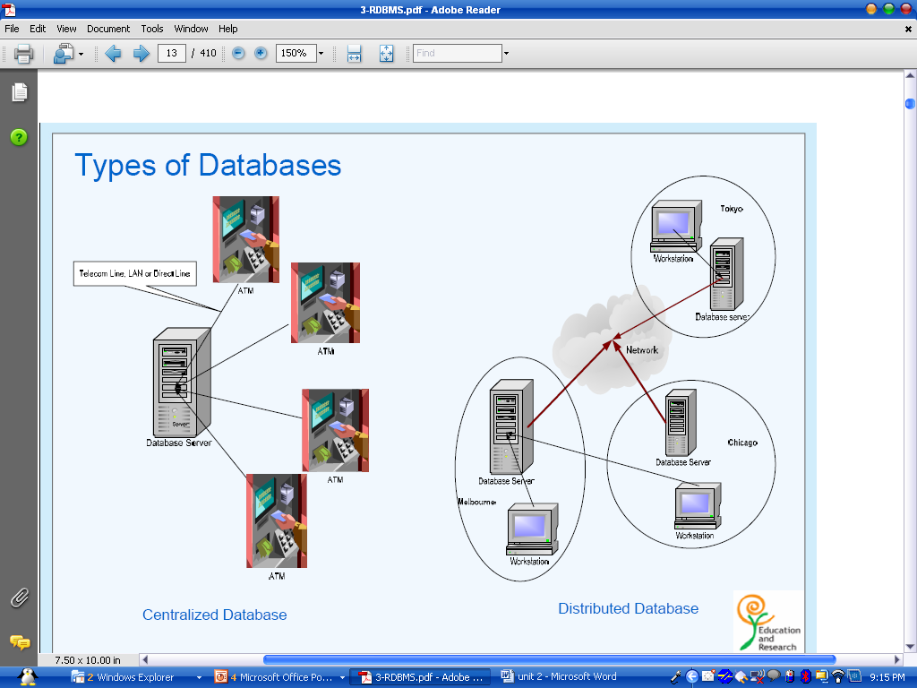

Slide 23
Centralized Database
• All data is located at a single site
• Allows for greater control over accessing
and updating data
Main Drawback
Single point failure
• Vulnerable to failure as they depend on the
availability of resources at the central site

Slide 24
Example
The account information of customers is stored in a particular branch office of a bank. This information must be shared across all Automated Teller Machines (ATM), so that customers can withdraw money from their accounts.
Instead of storing the customer information in every ATM machine it can be stored at a common place (the branch office of the bank) and shared over a network.

Slide 25
Distributed Database
The database is stored on several computers - from personal computers up to mainframe systems
Computers in a distributed system communicate with one another through various communication media, such as high speed networks or telephone lines
Distributed databases are geographically separated and managed.
Distributed databases are separately administered.
Distributed databases have a slower interconnection

Slide 26
Example
Consider the bank system. The bank’s head office is located at Chennai and the branch offices are at Vellore and Kanchipuram .
The bank database is distributed across the branch offices. The branch offices are connected through a network

Slide 27
Distributed Database
Approaches in Data Storage
Replication – The system maintains several identical copies of the relation and stores each replicas at different site
Fragmentation – The system partitions the relation into several fragments and stores each fragment at a different site.

Slide 28
Advantages of Replication
Availability- if one of the sites fails, then the relation can be found in another site.
Increased Parallelism - allowing several accesses to database results only reading.
Disadvantage of Replication
Increased overhead on update – The system must ensure all the replicas are consistent (correct) results in erroneous computation.

Slide 29
Database Development
First, develop a Conceptual design - an abstract model of the database from the user or business perspective
Second, organize with Entity-Relationship (ER) modeling
process of planning the database design
Entity classes ⇨ Instance ⇨ Identifiers ⇨ Relationships
Professor
ID Number
Name
Department
Course
Course Number
Course Name
Course Time
Course Place
can have
1:M
1:1

Slide 30
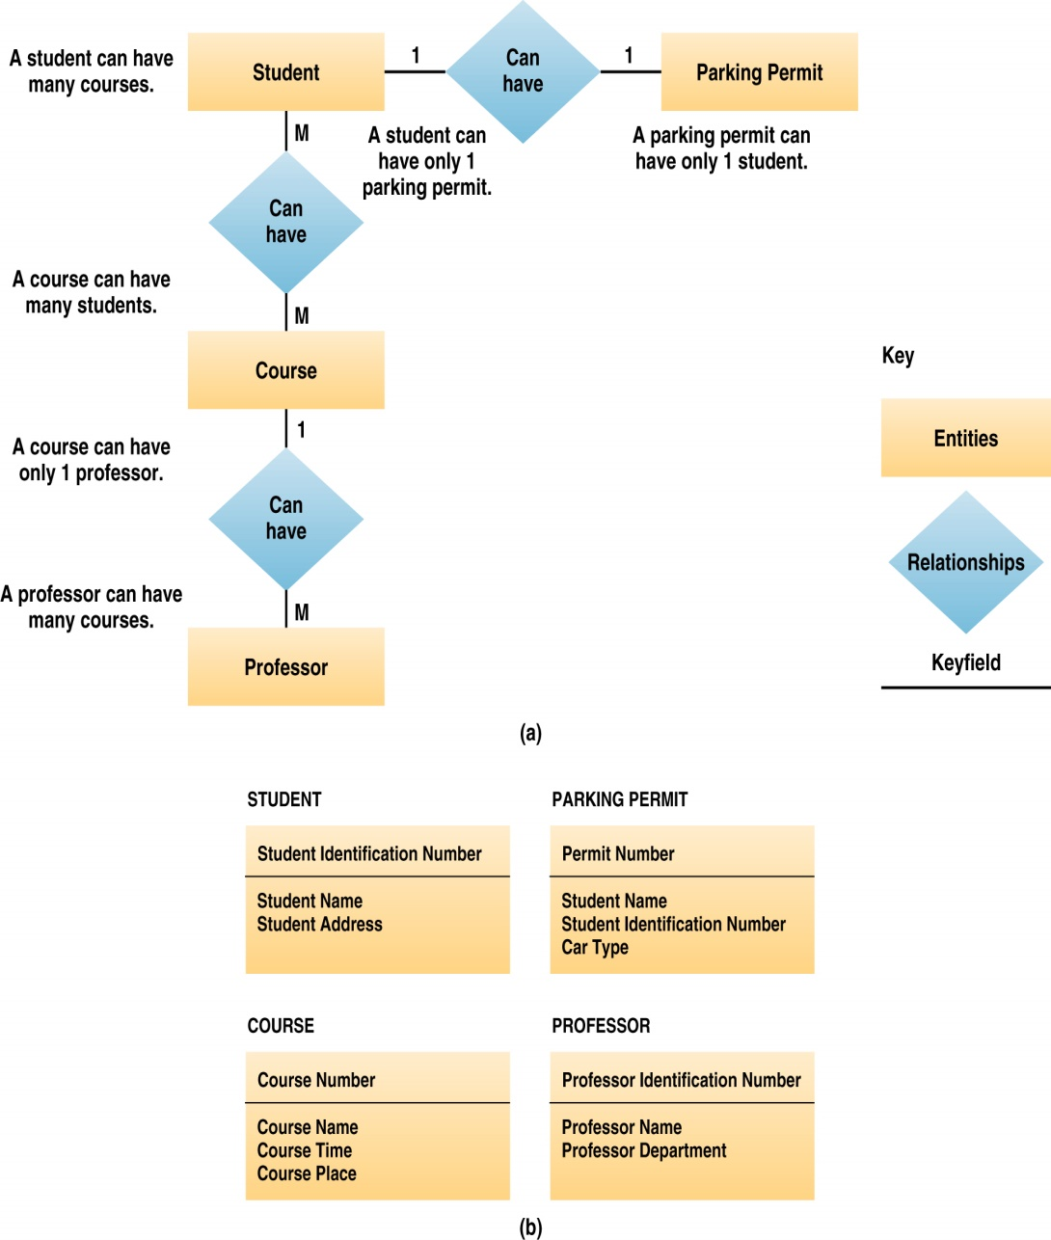
Entity-relationship model
Types of relationships:
One-to-one: a student has one schedule; a schedule belongs to one student
One-to-many: a course has one professor; a professor has one or more courses
Many-to-many: a student has one or more courses; a course has one or more students

Slide 31
Database Development
Third, analyze the data structure by applying the Normalization process
method that reduces a relational database to its most streamlined form
Helps achieve
minimum redundancy
maximum data integrity
best processing performance

Slide 32
Non-normalized table and its problems
* If an order contains many parts, you will have many repeating groups of part information. How will you know how much space to set aside for all the groups of part information?
* The customer number, name, address, etc. must be repeated in every order. If the customer moves, how will you make sure that all occurrences of the address get updated correctly in all the order
records?

Slide 33
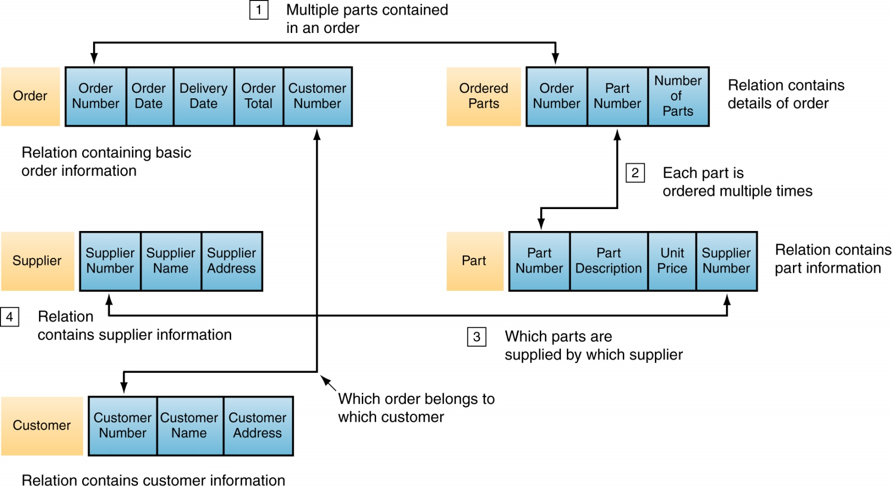
Normalized Relation

Slide 34
Database Development
Fourth, physically implement the data structure in the database management system software
Create tables
Define fields and field properties
Establish primary keys
Define table relationships
Add actual data (records) to tables

Slide 35
Database Management Systems
A set of software programs that provide access to a database
Data is stored in one location, from which it can be updated and retrieved
Application programs are given access to the stored data by various mechanisms
Maintaining the integrity of stored information
Managing security and user access
Recovering information when the system fails
Accessing various database functions from within an application

Slide 36
DBMS: Logical versus Physical View
Logical view - represents data in a format that is meaningful to a user (e.g., tables with fields and records)
Physical view - deals with the actual, physical arrangement and location of data in the direct access storage devices (DASD)
DBMSs shield the user from having to know about the physical location of the data; user only has to know the logical way it’s organized

Slide 37
DBMS Components
Data Model
Defines the way data are conceptually structured
Data Definition Language (DDL)
Used to define the content and structure of the data base
Users define their logical view (schema) of the database using the DDL
Physical characteristics of records and fields are defined
Relationships, primary keys, and security can be established

Slide 38
More DBMS Components
Data Manipulation Language (DML)
Used to query the contents of the database, store or update information in the database, and develop database applications
Structured query language (SQL) - most popular relational database language
Data Dictionary
stores definitions of data elements and data characteristics

Slide 39
DBMS Benefits
Improved strategic use of corporate data
Reduced complexity of IS environment
Reduced data redundancy and inconsistency
Enhanced data integrity
Application/data independence
Improved security
Reduced development and maintenance costs
Increased data access

Slide 40
Traditional file structures lead to numerous data management problems
DBMS help resolve many of those problems
Users are concerned with the logical view of data.
When organizations have created well structured databases, decision making and insight will improve through data warehouses and the use of data mining tools.

Slide 41
Flat Files
Characteristics:
Data is stored as records in regular files
Records usually have a simple structure and fixed number of fields
For fast access may support indexing of fields in the records
No mechanisms for relating data between files
One needs special programs in order to access and manipulate the data

Slide 42
Relational Database
Characteristics:
Data is organized into tables: rows & columns
Each row represents an instance of an entity
Each column represents an attribute of an entity
Metadata describes each table column
Relationships between entities are represented by values stored in the columns of the corresponding tables (keys)
Accessible through Standard Query Language (SQL)

Slide 43
SQL
ANSI (American National Standards Institute) standard computer language for accessing and manipulating database systems.
SQL statements are used to retrieve and update data in a database.
Includes:
Data Manipulation Language (DML)
Data Definition Language (DDL)

Slide 44
Data Manipulation Language
Syntax for executing queries, updating, inserting, and deleting records.
SELECT - extracts data from one or more table
INSERT INTO - inserts new data into a table
UPDATE - updates data in a table
DELETE FROM - deletes data from a table

Slide 45
DML Example
Select all Escherichia coli K12 genes which are in the 1MB-2MB region of the chromosome:
SELECT *
FROM Organism, Gene
WHERE
Organism.Name=“Escherichia coli K12” AND Organism.Accession=Gene.OAccession AND Gene.Start>=1,000,000 AND
Gene.End<=2,000,000

Slide 46
DML Example (cont.)
INSERT INTO Gene
(Name, Accession, OAccession, Start, End, Strand, Sequence)
VALUES
(“thrL”, 16127995,”NC_000913”,190,255,’+’,”thr operon leader peptide”, “MKRI…”)
UPDATE Gene SET Start=160 WHERE Accession= ”NC_000913”
DELETE FROM Gene WHERE Accession= ”NC_000913”

Slide 47
Data Definition Language
Syntax for creating ,editing, deleting:
Databases
Tables
Views
Indexes
Constraints
Users
Privileges

Slide 48
DDL Examples
CREATE DATABASE Microbial;
CREATE TABLE Organism (
Name varchar(100)
Size int(10)
Gc decimal(5)
Accession varchar(10)
Release date(8)
Center varchar(100));
ALTER TABLE Organism ADD Sequence varchar;
DROP TABLE Organism;

Slide 49
DBMS
Software package for defining and managing a database.
Examples:
Proprietary: MS Access, MS SQL Server, DB2, Oracle, Sybase
Open source: MySql, PostgreSQL

Slide 50
DBMS Advantages
Program-data independence
Minimal data redundancy
Improved data consistency & quality
Access control
Transaction control
Improved accessibility & data sharing
Increased productivity of application development
Enforced standards

Slide 51
Data Models

Slide 52
A data model is a collection of concepts for describing data.
Types of Data Model
1.Conceptual or Semantic Data Model
The Conceptual or Semantic Data Model provides an environment to the user for interacting with the data base.
The user can formulate his queries pertinent to the data base within the frame of the conceptual model.
2.Physical Data Model
The Physical Data Model helps the data base administrator to organize the data and store them in the computer so that subsets of the data relevant to the user’s request can be processed efficiently.

Slide 53
Types of Conceptual Data Model
Relational Data Model
Hierarchical Data Model
Network Data Model

Slide 54
Relational Data Model
The relational model of data is the most widely used model today.
Main concept: relation, basically a table with rows and columns.
A relational data base is composed of one or more relations.
Each can be visualized as a table of data or file.
In any relation no two rows can be identical, and the ordering of the rows should not be significant.
An attribute or set of attributes whose values uniquely identify a row of relations is called key.
If a relation has more than one key, it is preferred to designate one of them as the primary key.

Slide 55
Education Database
For each course; Course number, course title, course description, details of prerequisites course and details of all offerings.
For each prerequisites course; course number and title.
For each offering of a given course; Date, location, format, details about teacher and student.
For each teacher of a given offering; Employee number and name.
For each student of a given offering ; Employee number, name and grade.

Slide 56
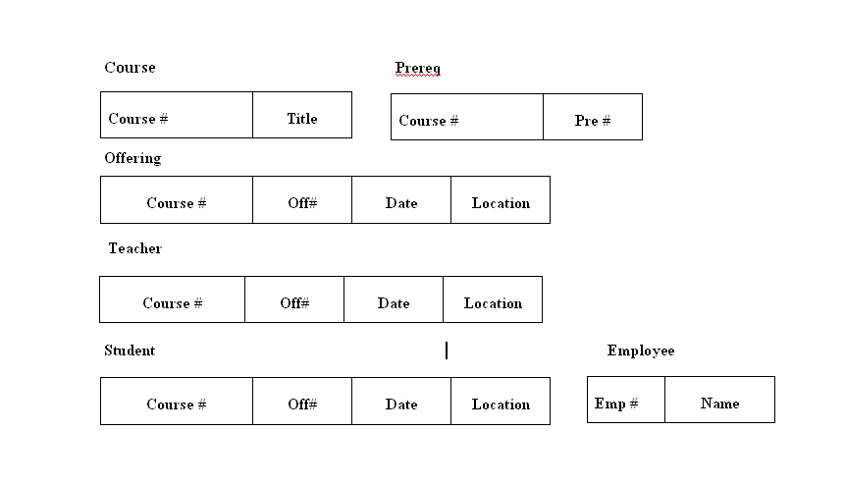
Example of Relational Data Base

Slide 57
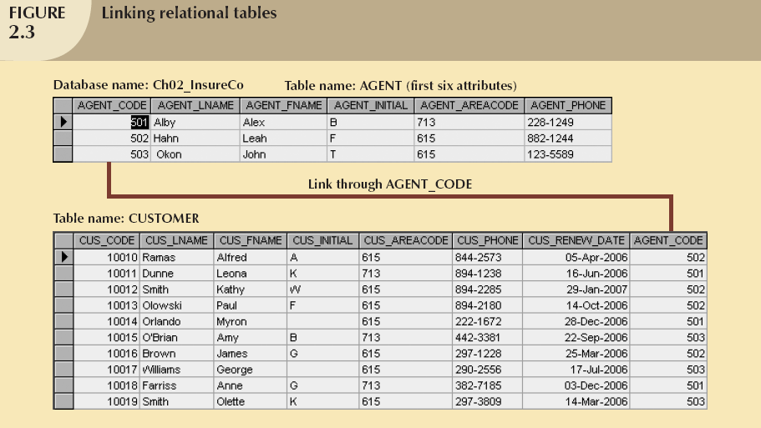
Example of Relational Data Base

Slide 58
Hierarchical Data Model
Data is represented by a tree-structure type of organization.
The hierarchical tree specifies what record types are
allowed to be included in the data base and the
permissible relations between record types.
Any record other than the root of the tree must be
connected with a superior record (parent).
To insert a record, the user must select the parent record
first
When a record is deleted, all the descendents of the rec

Slide 59
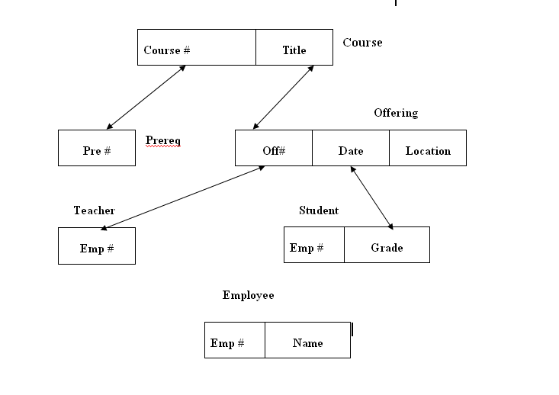
Example of Hierarchical Data Base

Slide 60
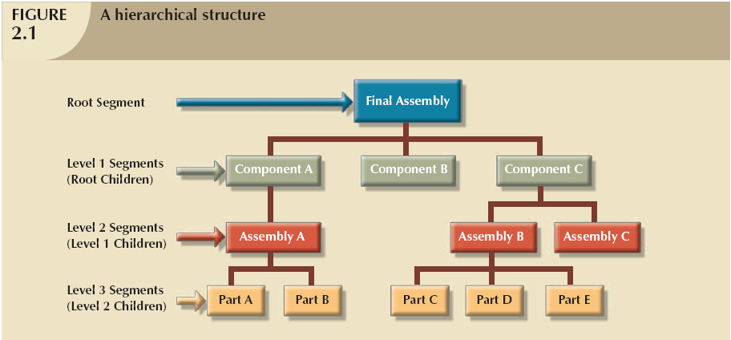
Example of Hierarchical Data Base

Slide 61
Network Data Model
Network data model is the generalization of the hierarchical data model.
In the network model,a segment can have multiple parent segments.
In general, the segments are grouped as levels but logical associations can exist between segments belonging to any level.
Difference child can have multiple parents
The data structure is many-to-many instead of one-to-many.

Slide 62
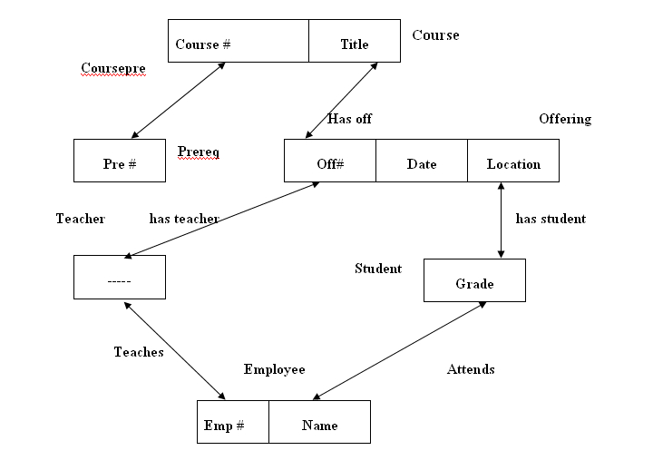
Example of Network Data Base

Slide 63
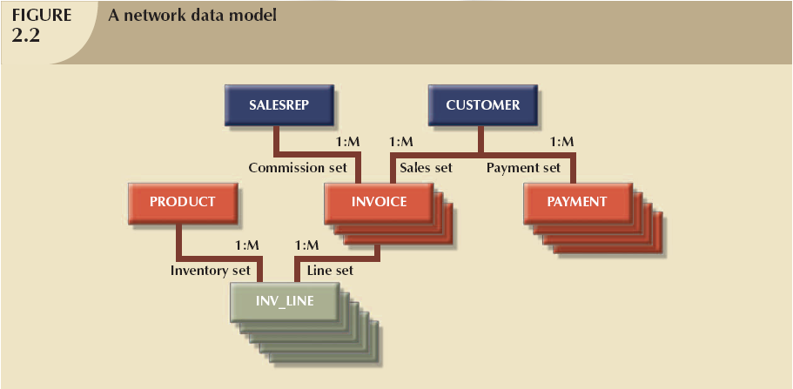
Example of Network Data Base

Slide 64
Comparison of the Models
Ease of use
Efficient of implementation.

Slide 65
E-R Diagram

Slide 66
LIBRARY MANAGEMENT SYSTEM
A library consists of
a section, a member, a book, a granter, a publisher.
Section has section id, name and phone number
Member has member id, address, telephone, occupation, member name.
Book has call number, title, author, price.
Publisher has publisher id, name, address, phone number.
Granter has national identify card number, name, address, phone.

Slide 67
Member name can be divided into first name, middle name, last name.
Key
The section, member, book, granter, publisher are uniquely identified by section id, member id, call number, publisher id, national id card number respectively.
Relationship
One section has many books but one book should keep in one section.
One member can borrow many books.
Many books may publish by one publisher otherwise one publisher may be published many books.

Slide 68
STEP-1: ->IDENTIFYING THE ENTITIES
The entities are
SECTION
MEMBER
BOOK
PUBLISHER
GRANTER

Slide 69
STEP-2:-> IDENTIFYING THE RELATIONSHIPS
One section has many books but one book should keep in one section. It is 1: N Relationship.
One member can borrow many books. It is 1 : N Relationship.
Many books may publish by one publisher otherwise one publisher may be published many books. It is N : 1 Relationship.
Many member may have one Granter otherwise one Granter grants for many members. It is N: 1 Relationship.

Slide 70
STEP-3: ->IDENTIFYING KEY ATTRIBUTES
SECTION, SECTION ID
MEMBER, MEMBER ID
BOOK, CALL NUMBER
PUBLISHER PUBLISHER ID
GRANTER NATIONAL IDENTIFY CARD NUMBER

Slide 71
STEP-4:-> OTHER RELEVANT ATTRIBUTES
SECTION NAME, PH NO
MEMBER ADDRESS, TELEPHONE, OCCUPATION, MEMBER NAME
PUBLISHER NAME, ADDRESS, PHONE NUMBER
BOOK TITLE, AUTHOR, PRICE
GRANTER NAME, ADDRESS, PHONE NUMBER, POS

Slide 72
Hospital Management System
A hospital consists of
Patient
Doctor
Lab reports
Rooms
Bill Details

Slide 73
IDENTIFYING KEY ATTRIBUTES
Patient id
Doctor id
Lab no.
Room no.
Bill no.

Slide 74
OTHER RELEVANT ATTRIBUTES
Patient- Pid, age, address, gender, name, phone, weight, doctorid, disease
Doctor- Doctorid, dept, Doctor name, phone
Lab report- lab no, amount, pid, date, category, doctorid
Room- room no, room type, status
Bill- bill no, pid, doctorid, room charge, doctor fee, advance, no of days, operation charge, etc.

